Slide 1
Module 5
Prototyping & Visualization
Dr Priyanjali Gogikar
SEEE, VIT Bhopal
Priyanjali.Gogikar@vitbhopal.Ac.In

Slide 2
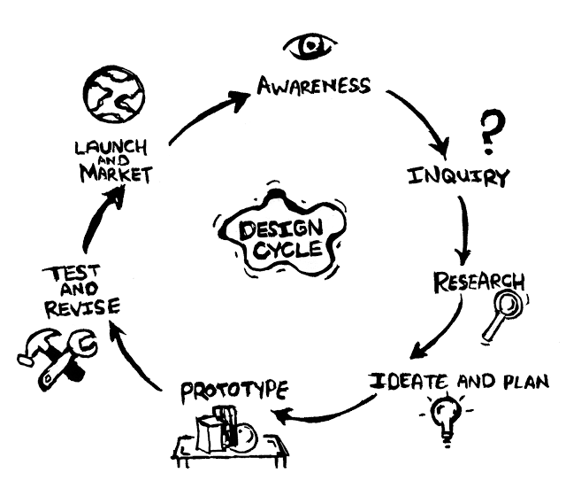
Design Cycle Model
The Design Cycle Model is central to a student’s understanding of design activities.
The DCM comprises of mainly six stages, as follows:
Identifying the needs (Awareness)
Analysing, researching and specifying requirements (Inquiry & Research)
Generating ideas and solutions (Ideate and Plan)
Developing the chosen solution (Prototype)
Realising the chosen solution (Test and Revise)
Testing and evaluating the chosen solution (Launch and Market)

Slide 3



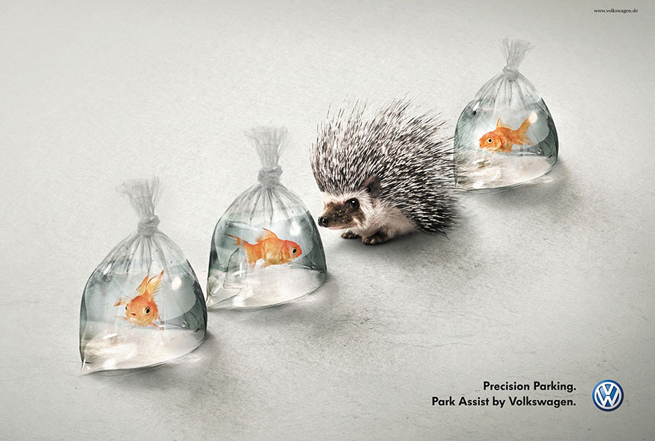
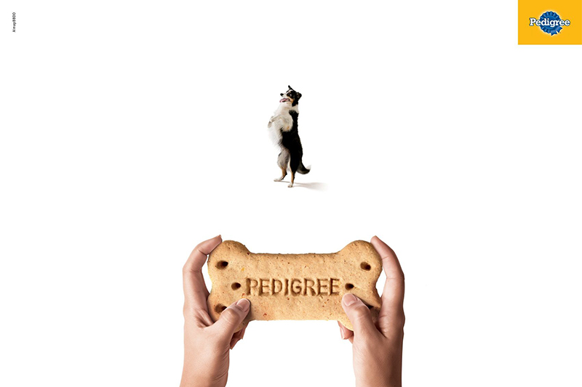
METAPHOR

Slide 4
Metaphor Method in Concept generation
A metaphor allows us to understand one concept in terms of another, enriching our mental imagery and imbuing concepts with meaningful attributes.
Metaphors are well studied in design, for example, in branding, communication and the design of computer interfaces.
The metaphors we use constantly in our everyday language profoundly influence what we do because they shape our understanding.
They help us describe and explore new ideas in term and concepts found in more familiar domain.
Metaphor is a fascinating phenomenon, but it is also complex and multi-faceted, varying in how it is manifested in different modes of expression, languages, cultures.

Slide 5
Metaphors can :
a) Explain abstract or complex concepts
b) Create a sense of familiarity
c) Trigger emotions
d) Draw attention to your site or certain components of it
e) Motivate users to take action

Slide 6
VISUAL
Lakoff and Johnson
Metaphors
Classification-I
INDEXCIAL
Contextual
Forceville
Classification-2
Metaphors
Hybrid

Slide 7
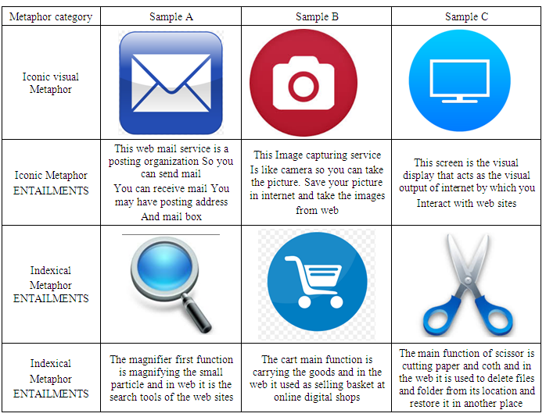

Slide 8
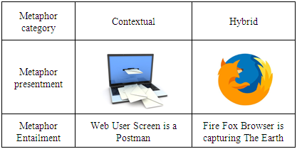

Slide 9
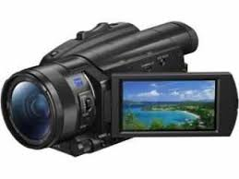

Blend method
concepts involving an innovative concept which inherits partial properties from both the two base concepts but is different from the two base concepts.
Camcorder
Emoticons

Slide 10
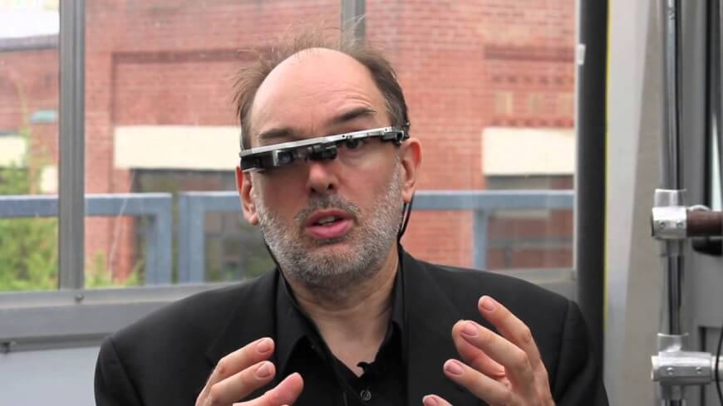
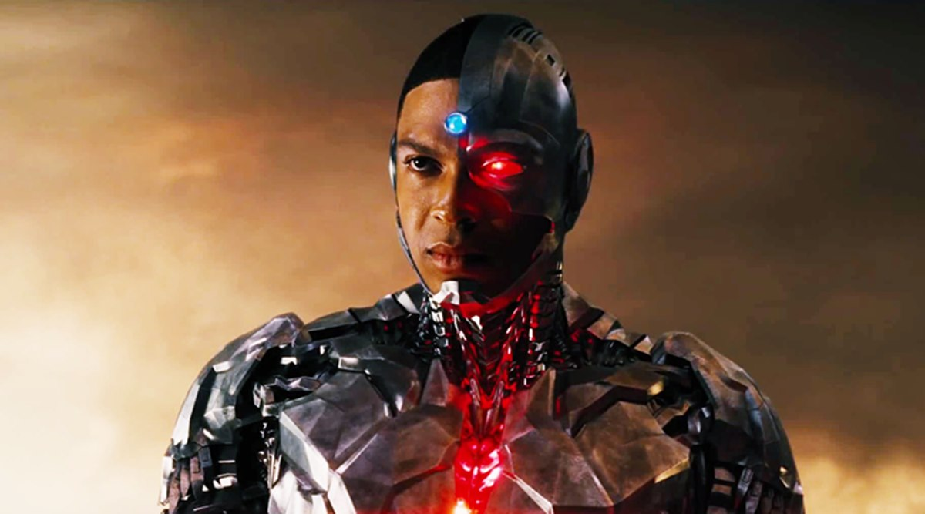
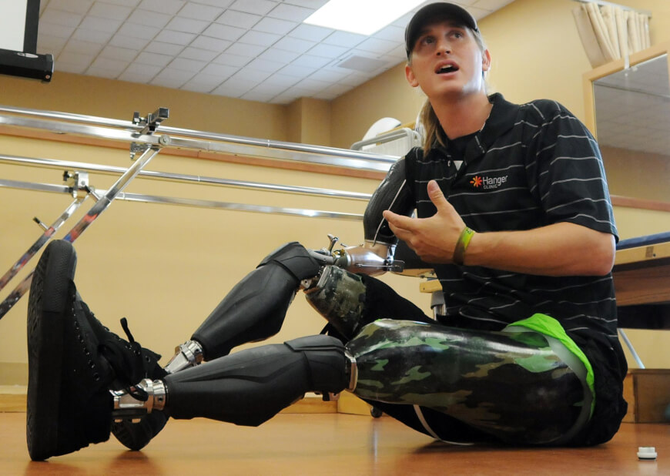
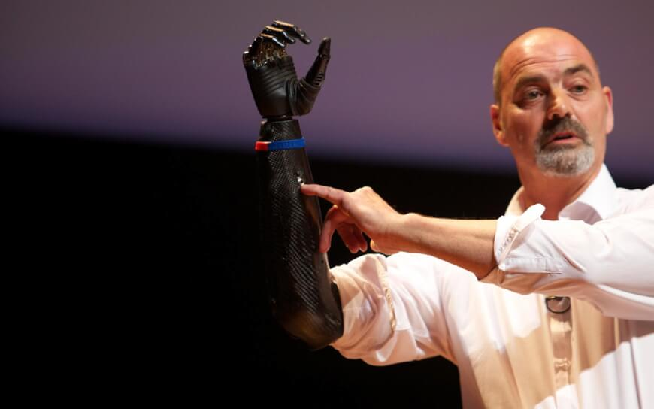
CYBORG

Slide 11


Thematic Method

Slide 12
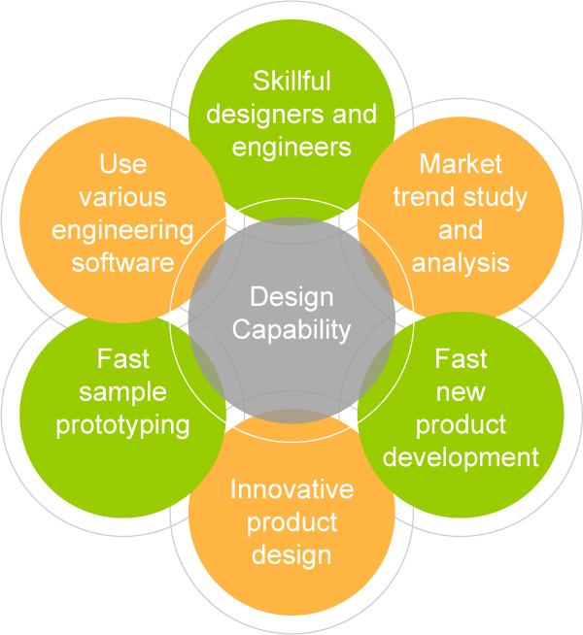
Design Capability
Design capacity is defined as an organization's proficiency to gather and assimilate knowledge about design.
Design Capability assessments helps to identify design limits and potential problems early in the design process.

Slide 13
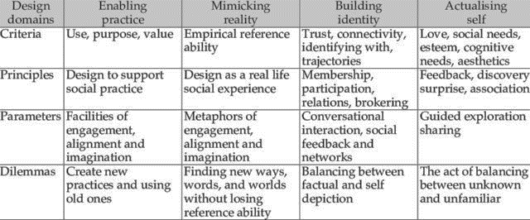
Sociability
Source: Conole, G., & Culver, J. (2009). Cloudworks: Social networking for learning design. Australasian Journal of Educational Technology, 25(5).

Slide 14

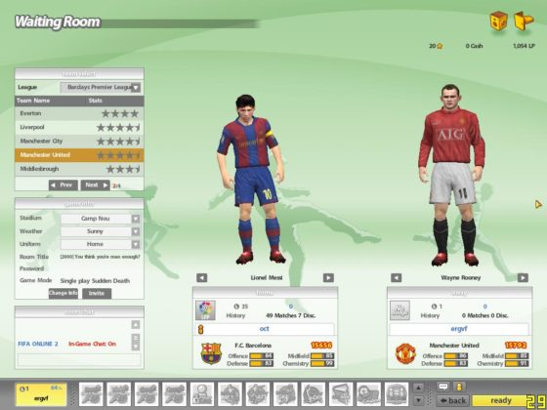

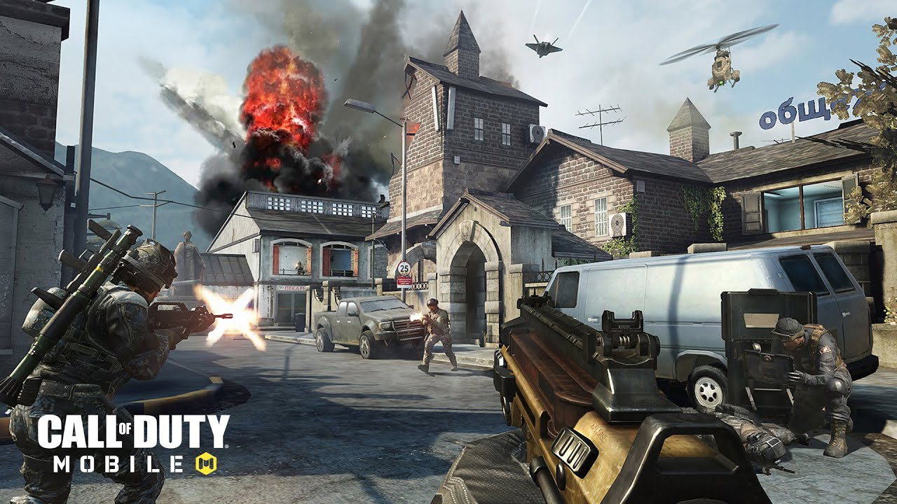

Slide 15
Prototyping
Prototyping is an experimental process where design teams implement ideas into tangible forms from paper to digital.
Teams build prototypes of varying degrees of fidelity to capture design concepts and test on users.
With prototypes, you can refine and validate your designs so your brand can release the right products.
It’s an essential part of user experience (UX) design that usually comes after ideation, where you/your team have created and selected ideas that can solve users’ needs. In prototyping, you craft a simple experimental model of your proposed product so you can check how well it matches what users want through the feedback they give.

Slide 16
The advantages of prototyping are that you:
Have a solid foundation from which to ideate towards improvements—giving all stakeholders a clear picture of the potential benefits, risks and costs associated with where a prototype might lead.
Can adapt changes early
Show the prototype to your users so they can give you their feedback to help pinpoint which elements/variants work best and whether an overhaul is required.
Provide a sense of ownership to all concerned stakeholders—therefore fostering emotional investment in the product’s ultimate success.
Improve time-to-market by minimizing the number of errors to correct before product release.
Prototyping can help catch potentially costly errors well in advance.

Slide 17
Low-Fidelity vs. High-Fidelity Prototyping
Fidelity refers to the level of detail and functionality you include in your prototype. Usually, this will depend on your product’s development stage.
Low-fidelity Example: Paper prototypes
Pros: Fast and cheap; disposable; easy to make changes and test new iterations; allow a quick overall view of the product; anyone can produce them; encourage design thinking since prototypes are visibly not finalized.
Cons: Lack of realism, so users might have a hard time giving feedback; hard to apply results from crude early versions; may be too basic to reflect the user experience of the finished product; can oversimplify complex issues; lack of interactivity deprives users of direct control; users must imagine how they would use the product.
High-fidelity Example: Digital prototypes created on software such as Sketch or Adobe XD
Pros: Engaging—all stakeholders have the vision realized in their hands and can judge how well it matches users’ needs and solves their problems; testing will yield more accurate, more applicable results; versions closest to the final product enable you to predict how users will take to it in the marketplace.
Cons: Longer/costlier to create; users are more likely to comment on superficial details than on content; after hours of work, you the designer are likely to dislike the idea of making changes, which can take considerable time; users may mistake the prototype for the finished product and form biases.

Slide 18
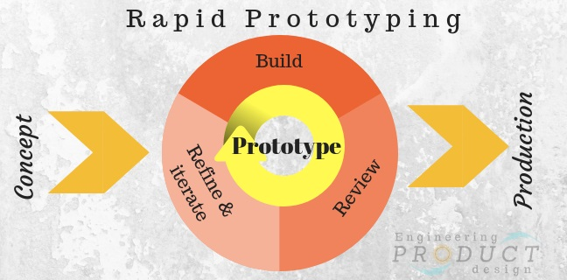
Rapid Prototyping
Its simplest form, the process of creating prototypes quickly to visually and functionally evaluate an engineering product design.
The key difference from the traditional prototyping process is that a team focuses on building just enough of a prototype—something that users can test, without additional features.
The whole concept of rapid prototyping is based on the idea that by setting a direction for a design team and iterating rapidly, it’s possible to create a product that will have the maximum value for people who will use it.

Slide 19
Prototype - Creating a solution that can be reviewed and tested by users/stakeholders.
Review - Giving a prototype to users/stakeholders and collect feedback that helps the team understand what works well and what doesn’t.
Refine - Based on feedback, the team identifies areas that need to be refined or reworked. The list of required changes will form a scope of work for the next design iteration.
Why is rapid prototyping important?
Faster new product development
Early stage design/concept validation of form, fit, and function of the design
Final stage product verification against the technical requirement and business objectives
It allows functionality testing to test the objectives of the concept and to finalize the specification
Prototype gives the end user, client, customer, user participants hands-on user experience to get feedback

Slide 20
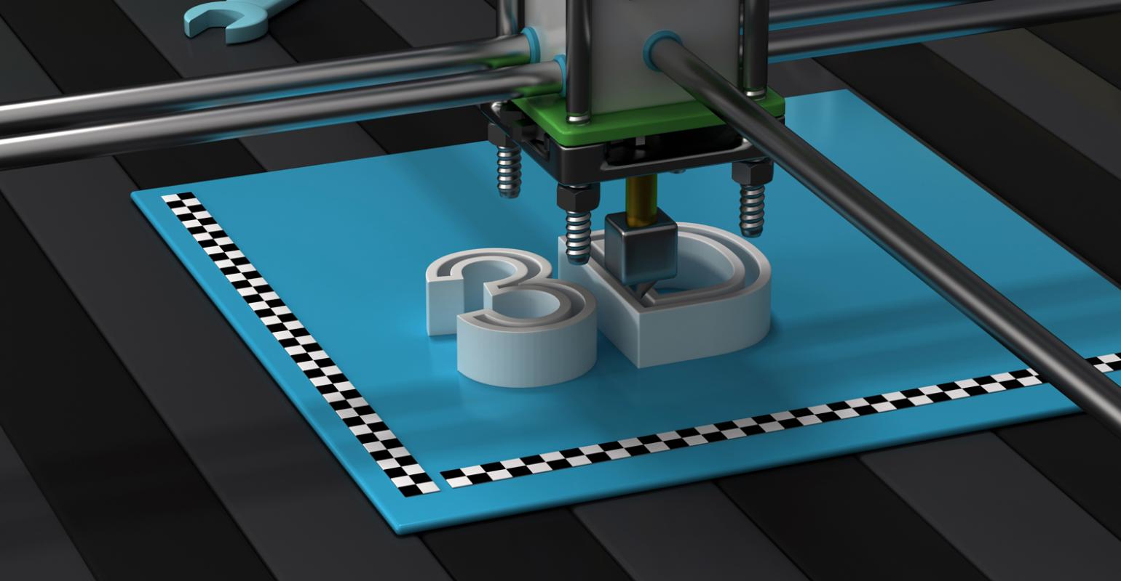
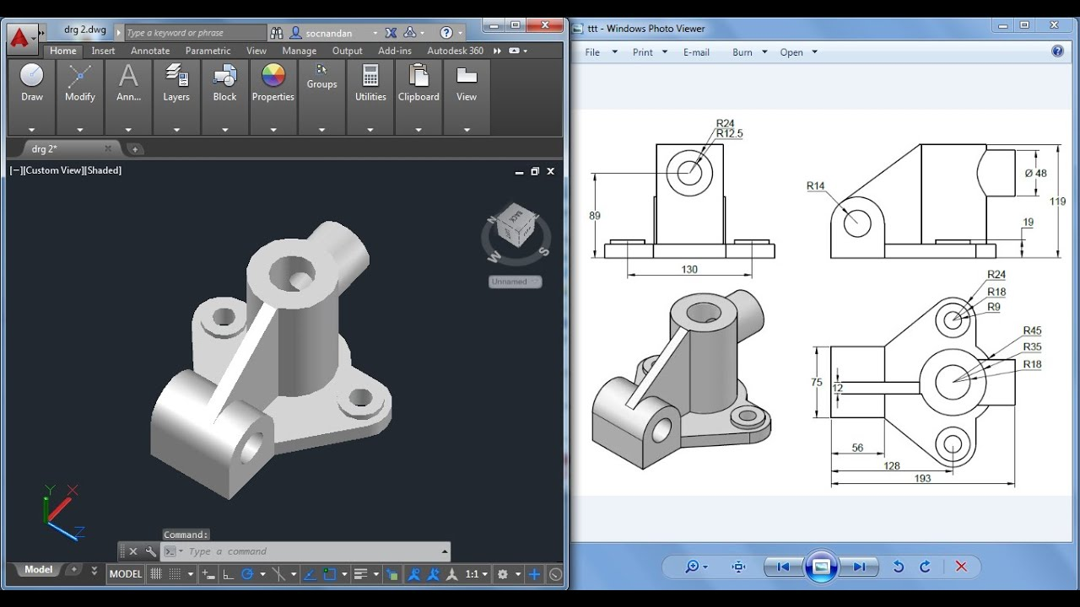
Additive Rapid prototyping -3D printing
One type of Rapid Prototyping is known as 3D printing, which is an additive manufacturing technology.
The process begins with taking a virtual design from modelling or CAD software.
The 3D printing machine reads the data from the CAD drawing and lays down successive layers of liquid, powder, or sheet material, and builds up the physical model from a series of cross sections.
These layers, which correspond to the virtual cross section from the CAD model, are automatically joined together to create the final shape.

Slide 21
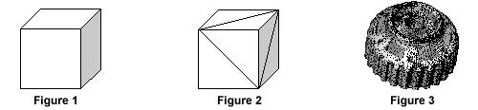
STL file
An STL file stores information about 3D models.
This format describes only the surface geometry of a three-dimensional object without any representation of color, texture or other common model attributes.
These files are usually generated by a computer-aided design (CAD) program, as an end product of the 3D modeling process. “.STL” is the file extension of the STL file format.
It’s widely believed to be an abbreviation of the word STereoLithography, though sometimes it is also referred to as “Standard Triangle Language” or “Standard Tessellation Language”.
For a simple model such as the box shown in figure 1, its surfaces can be approximated with twelve triangles, as shown in figure 2. The more complex the surface, the more triangles produced, as shown in figure 3.

